Slide 1
Stanford ME469: Introduction to the low-Mach Number Approximation
Stefan P. Domino
Computational Thermal and Fluid Mechanics
Sandia National Laboratories SAND2018-4536 PE

Slide 2
Introduction to the low-Mach Number Approximation: Outline
Variable density, non-isothermal equation set
DOF vs Equation count
Non-dimensional form
Asymptotic Expansion
Derived low-Mach Equation Set
The Role of Pressure
Motion and Thermodynamic
Conclusions

Slide 3
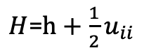
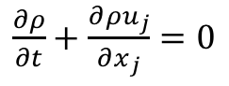
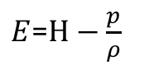
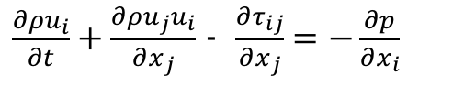
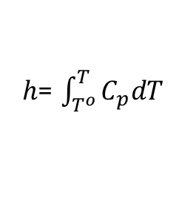
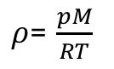
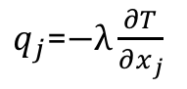
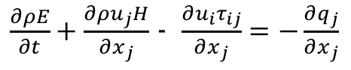
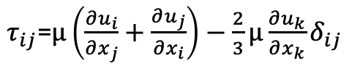
Consider a Variable Density, non-Isothermal Fluid Flow System
Consider the variable density (non-isothermal) equations of motion (momentum and continuity) with energy transport
See Paolucci (1982) or Baum (1978) for the low-Mach pedigree
Number of Equations = (3+nDim) = Number of unknowns
DOF
Density, ρ
Pressure, p
Velocity, u_{i}
Total energy, E
Total enthalpy, H
Static enthalpy, h
Temperature, T
Properties:
Viscosity, μ
Specific heat, C_{p}
Thermal conductivity, λ
Constitutive Relationships
Ideal gas law (+1)
Newtonian stress, τ_{ij}
Heat flux vector, q
Total enthalpy, H
Static enthalpy, h
CpdT
$\frac{∂ρ}{∂t}+\frac{∂{ρu}_{j}}{∂x_{j}}$ $=0$
$\frac{∂ρu_{i}}{∂t}+\frac{∂ρu_{j}u_{i}}{∂x_{j}}$ - $\frac{∂τ_{ij}}{∂x_{j}}=−\frac{∂p}{∂x_{i}}$
2+nDim
$\frac{∂ρE}{∂t}+\frac{∂ρu_{j}H}{∂x_{j}}$ - $\frac{∂u_{i}τ_{ij}}{∂x_{j}}=−\frac{∂q_{j}}{∂x_{j}}$
+1
$ρ$= $\frac{pM}{RT}$
$τ_{ij}$=$μ\left(\frac{∂u_{i}}{∂x_{j}}+\frac{∂u_{j}}{∂x_{i}}\right)−\frac{2}{3}μ\frac{∂u_{k}}{∂x_{k}}δ_{ij}$
$q_{j}$=$−λ\frac{∂T}{∂x_{j}}$
$E$=$H−\frac{p}{ρ}$
$H$=$h+\frac{1}{2}u_{ii}$
$h$= $\int_{T^{o}}^{T}{C_{p}dT}$

Slide 4
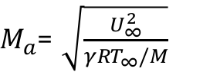
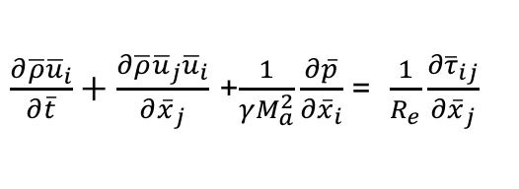
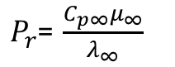
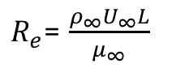
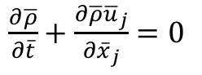
Dimensionless Form
Nondimensionalization is via a characteristic velocity and length scale
Note, as the Mach number approaches zero, the viscous work and kinetic energy terms become negligible
However, the momentum equation notes a singular due to the pressure gradient term
Conclusions: In the limit of zero Mach number, the momentum equation is not well defined and, in fact, singular
$\frac{∂\overline{ρ}}{∂\overline{t}}+\frac{∂\overline{ρ}{\overline{u}}_{j}}{∂{\overline{x}}_{j}}$ $=0$
$\frac{∂\overline{ρ}{\overline{u}}_{i}}{∂\overline{t}}+\frac{∂\overline{ρ}{\overline{u}}_{j}{\overline{u}}_{i}}{∂{\overline{x}}_{j}}$ +$\frac{1}{γM_{a}^{2}}\frac{∂\overline{p}}{∂{\overline{x}}_{i}}$= $\frac{1}{R_{e}}\frac{∂{\overline{τ}}_{ij}}{∂{\overline{x}}_{j}}$
$\frac{∂\overline{ρ}\overline{h}}{∂\overline{t}}+\frac{∂\overline{ρ}{\overline{u}}_{j}\overline{h}}{∂{\overline{x}}_{j}}$ = $−\frac{1}{{P_{r}R}_{e}}\frac{∂{\overline{q}}_{j}}{∂{\overline{x}}_{j}}+\frac{γ−1}{γ}\frac{∂\overline{p}}{∂\overline{t}}+\frac{γ−1}{γ}\frac{M_{a}^{2}}{R_{e}}\frac{∂{\overline{u}}_{i}{\overline{τ}}_{ij}}{∂{\overline{x}}_{j}}$ - $\frac{γ−1}{γ}$ $M_{a}^{2}\left(\frac{∂\overline{ρ}{\overline{u}}_{k}{\overline{u}}_{k}}{∂{\overline{x}}_{j}}+\frac{∂\overline{ρ}{\overline{u}}_{j}{\overline{u}}_{k}{\overline{u}}_{k}}{∂{\overline{x}}_{j}}\right)$
$R_{e}$= $\frac{ρ_{∞}U_{∞}L}{μ_{∞}}$
$P_{r}$= $\frac{C_{p∞}μ_{∞}}{λ_{∞}}$
$M_{a}$= $\sqrt{\frac{U_{∞}^{2}}{{γRT}_{∞}/M}}$

Slide 5
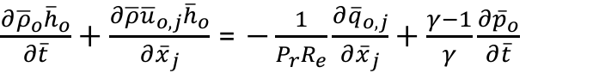
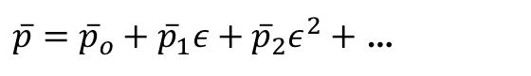
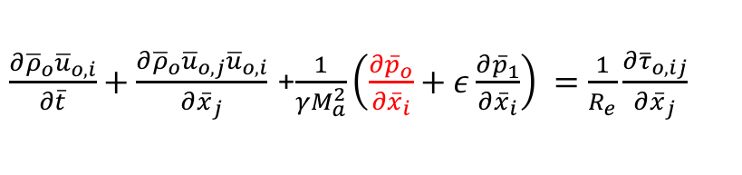
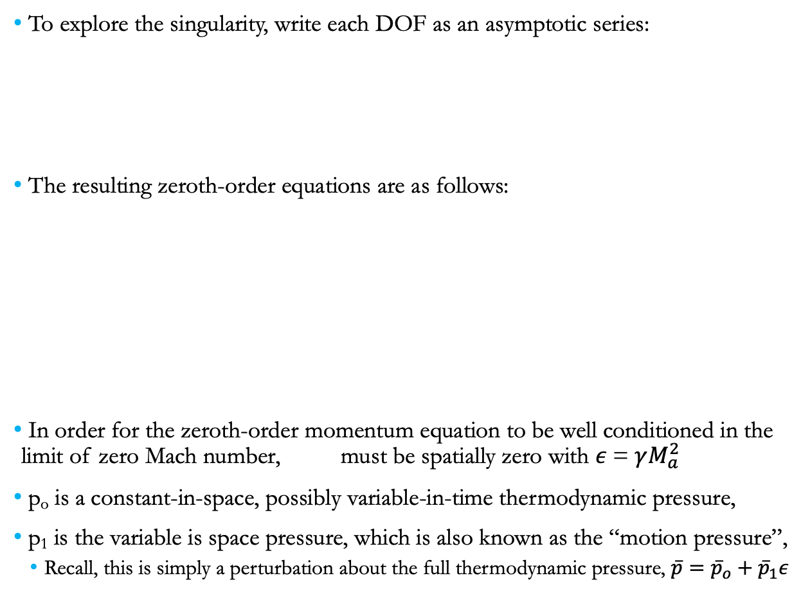
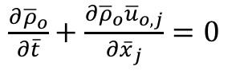
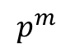
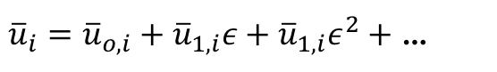
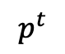
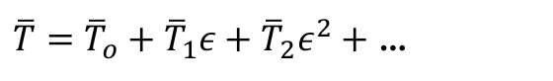
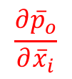
Exploration of the Pressure Singularity
To explore the singularity, write each DOF as an asymptotic series:
The resulting zeroth-order equations are as follows:
In order for the zeroth-order momentum equation to be well conditioned in the limit of zero Mach number, must be spatially zero with $ε$= $γM_{a}^{2}$
p_{o} is a constant-in-space, possibly variable-in-time thermodynamic pressure,
p₁ is the variable is space pressure, which is also known as the “motion pressure”,
Recall, this is simply a perturbation about the full thermodynamic pressure, $\overline{p}={\overline{p}}_{o}+{\overline{p}}_{1}ε$
$\overline{p}={\overline{p}}_{o}+{\overline{p}}_{1}ε+{\overline{p}}_{2}ε^{2}+$ …
${\overline{u}}_{i}={\overline{u}}_{o,i}+{\overline{u}}_{1,i}ε+{\overline{u}}_{1,i}ε^{2}+$ …
$\overline{T}={\overline{T}}_{o}+{\overline{T}}_{1}ε+{\overline{T}}_{2}ε^{2}+$ …
$\frac{∂{\overline{ρ}}_{o}}{∂\overline{t}}+\frac{∂{\overline{ρ}}_{o}{\overline{u}}_{o,j}}{∂{\overline{x}}_{j}}$ $=0$
Used in EOS/u_{i} eq
$\frac{∂{\overline{ρ}}_{o}{\overline{u}}_{o,i}}{∂\overline{t}}+\frac{∂{\overline{ρ}}_{o}{\overline{u}}_{o,j}{\overline{u}}_{o,i}}{∂{\overline{x}}_{j}}$ +$\frac{1}{γM_{a}^{2}}\left(\frac{∂{\overline{p}}_{o}}{∂{\overline{x}}_{i}}+ε\frac{∂{\overline{p}}_{1}}{∂{\overline{x}}_{i}}\right) =\frac{1}{R_{e}}\frac{∂{\overline{τ}}_{o,ij}}{∂{\overline{x}}_{j}}$
$\frac{∂{\overline{ρ}}_{o}{\overline{h}}_{o}}{∂\overline{t}}+\frac{∂\overline{ρ}{\overline{u}}_{o,j}{\overline{h}}_{o}}{∂{\overline{x}}_{j}}$ = $−\frac{1}{{P_{r}R}_{e}}\frac{∂{\overline{q}}_{o,j}}{∂{\overline{x}}_{j}}+\frac{γ−1}{γ}\frac{∂{\overline{p}}_{o}}{∂\overline{t}}$
$$\frac{∂{\overline{p}}_{o}}{∂{\overline{x}}_{i}}$$
$$p^{t}$$
$$p^{m}$$

Slide 6
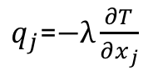
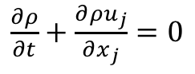
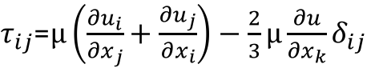
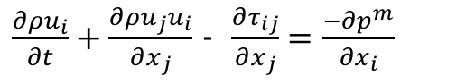
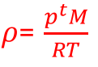
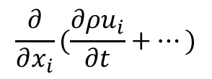
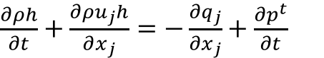
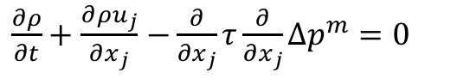
The Final low-Mach Number Equation Set
In dimensional form, the low-Mach system is as follows:
Ramifications?
We have effectively filtered out the acoustics, i.e., the wave speed is infinitely fast
Continuity is met over any finite length instantly
DOF/Equation system is: ρ, p^{m}, u_{i}, h; p^{t} is a constant for an open domain
In practice, a functional form for the motion pressure is derived:
- or
$\frac{∂ρ}{∂t}+\frac{∂{ρu}_{j}}{∂x_{j}}$ $=0$
DOF
Density, ρ
Pressure, p^{m}
Velocity, u_{i}
Total energy, E
Total enthalpy, H
Static enthalpy, h
Temperature, T
Properties:
Viscosity, μ
Specific heat, C_{p}
Thermal conductivity, λ
Constitutive Relationships
Ideal gas law
Newtonian stress, τ_{ij}
Heat flux vector, q
Total enthalpy, H
Static enthalpy, h
CpdT
$\frac{∂ρu_{i}}{∂t}+\frac{∂ρu_{j}u_{i}}{∂x_{j}}$ - $\frac{∂τ_{ij}}{∂x_{j}}=\frac{−∂p^{m}}{∂x_{i}}$
2+nDim
$\frac{∂ρh}{∂t}+\frac{∂ρu_{j}h}{∂x_{j}}$ $=−\frac{∂q_{j}}{∂x_{j}}+\frac{∂p^{t}}{∂t}$
$ρ$= $\frac{p^{t}M}{RT}$
$τ_{ij}$=$μ\left(\frac{∂u_{i}}{∂x_{j}}+\frac{∂u_{j}}{∂x_{i}}\right)−\frac{2}{3}μ\frac{∂u}{∂x_{k}}δ_{ij}$
$q_{j}$=$−λ\frac{∂T}{∂x_{j}}$
$h$= $\int_{T^{o}}^{T}{C_{p}dT}$
$$\frac{∂}{∂x_{i}}(\frac{∂ρu_{i}}{∂t}+…)$$
Pressure Poisson Equation
(PPE)
$\frac{∂ρ}{∂t}+\frac{∂{ρu}_{j}}{∂x_{j}}$ $−\frac{∂}{∂x_{j}}τ\frac{∂}{∂x_{j}}Δp^{m}=0$

Slide 7
Introduction to the low-Mach Number Approximation: Conclusions
Variable density, non-isothermal equation set allow for all length and time scales for a given physics
The non-dimensional form of the momentum equation is singular in the limit as Mach number approaches zero
low-Mach equations are derived by nondimensionalization and asymptotic expansion
For a low-Mach flow, the density and thermodynamic pressure are not strongly coupled by an equation of state, hence, stiffness arises as Ma->0
The constant-in-space thermodynamic pressure is used in the EOS
The low-Mach procedure filters the acoustics, which can not be of prime interest in the flow

